Slide 1
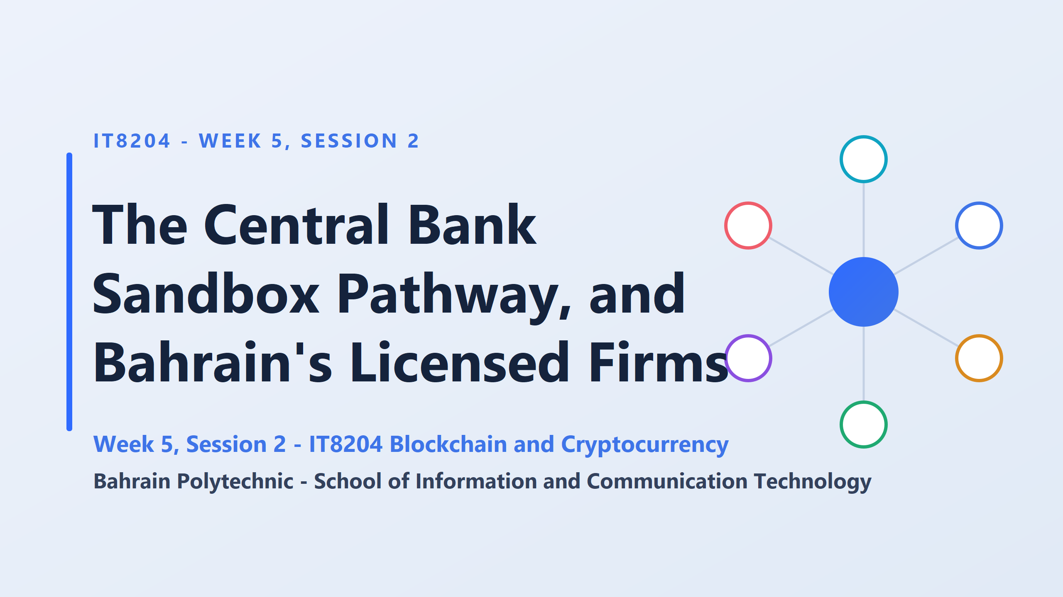
How does a crypto startup actually go from an idea on paper to a fully licensed, operating business with real customers?
To do this, a company follows what we call a Pathway.
Think of a pathway as a roadmap with official checkpoints or “gates”.
At each gate, the regulator—like the CBB—evaluates the project before letting it move to the next stage

Slide 2
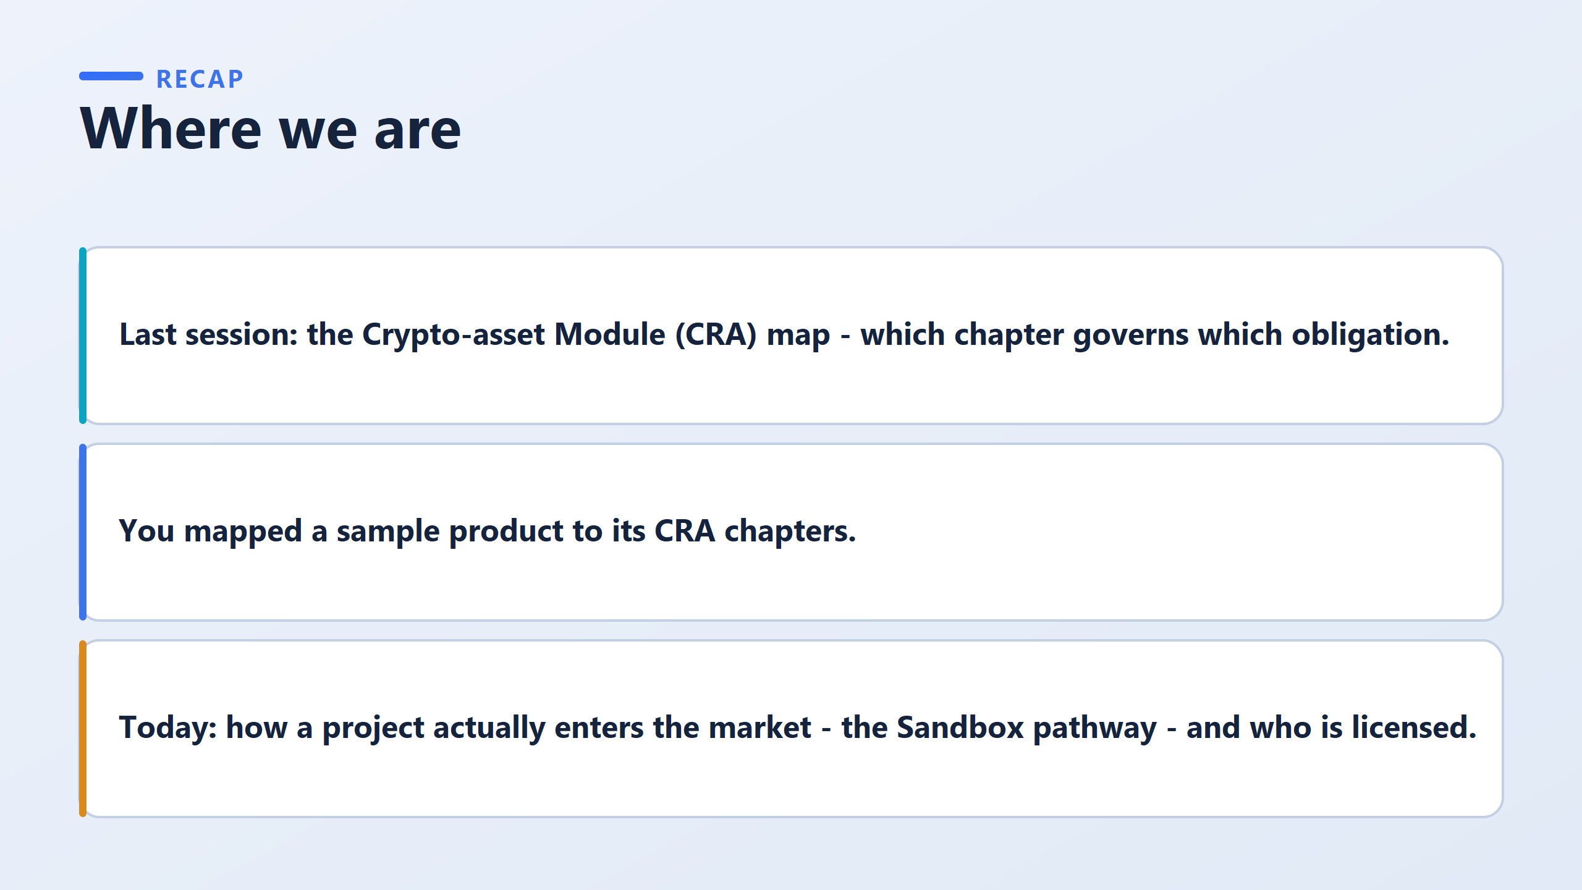
Imagine you created an amazing crypto app tonight.
What stops you from launching it tomorrow morning and charging customers?
It isn’t lack of coding skills or lack of funding—it’s permission.
Today, we’re going to map out exactly how firms get that permission.
This is essential knowledge for anyone entering the Fintech or blockchain sector

Slide 3
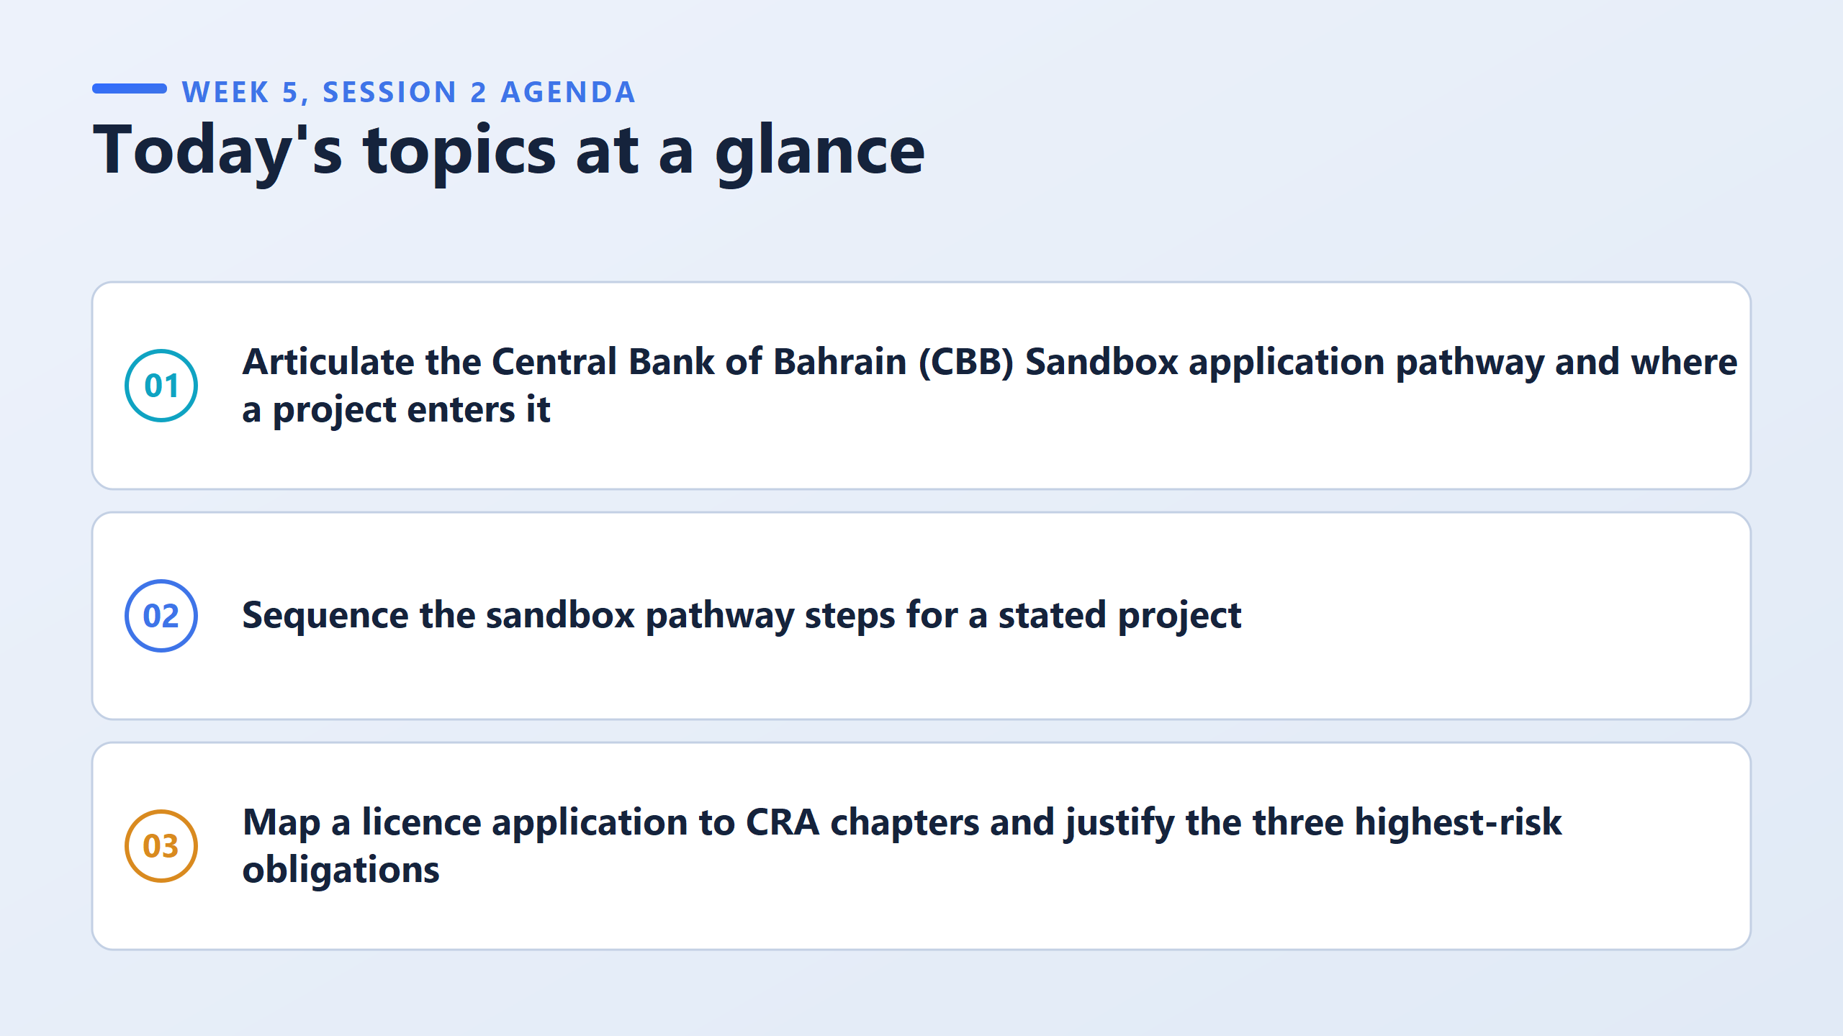
Map a licenced application to the chapters of the rulebook that govern it Then you justify which three obligations carry the highest risk
A list of three obligations with no reasons attached will not earn the marks

Slide 4
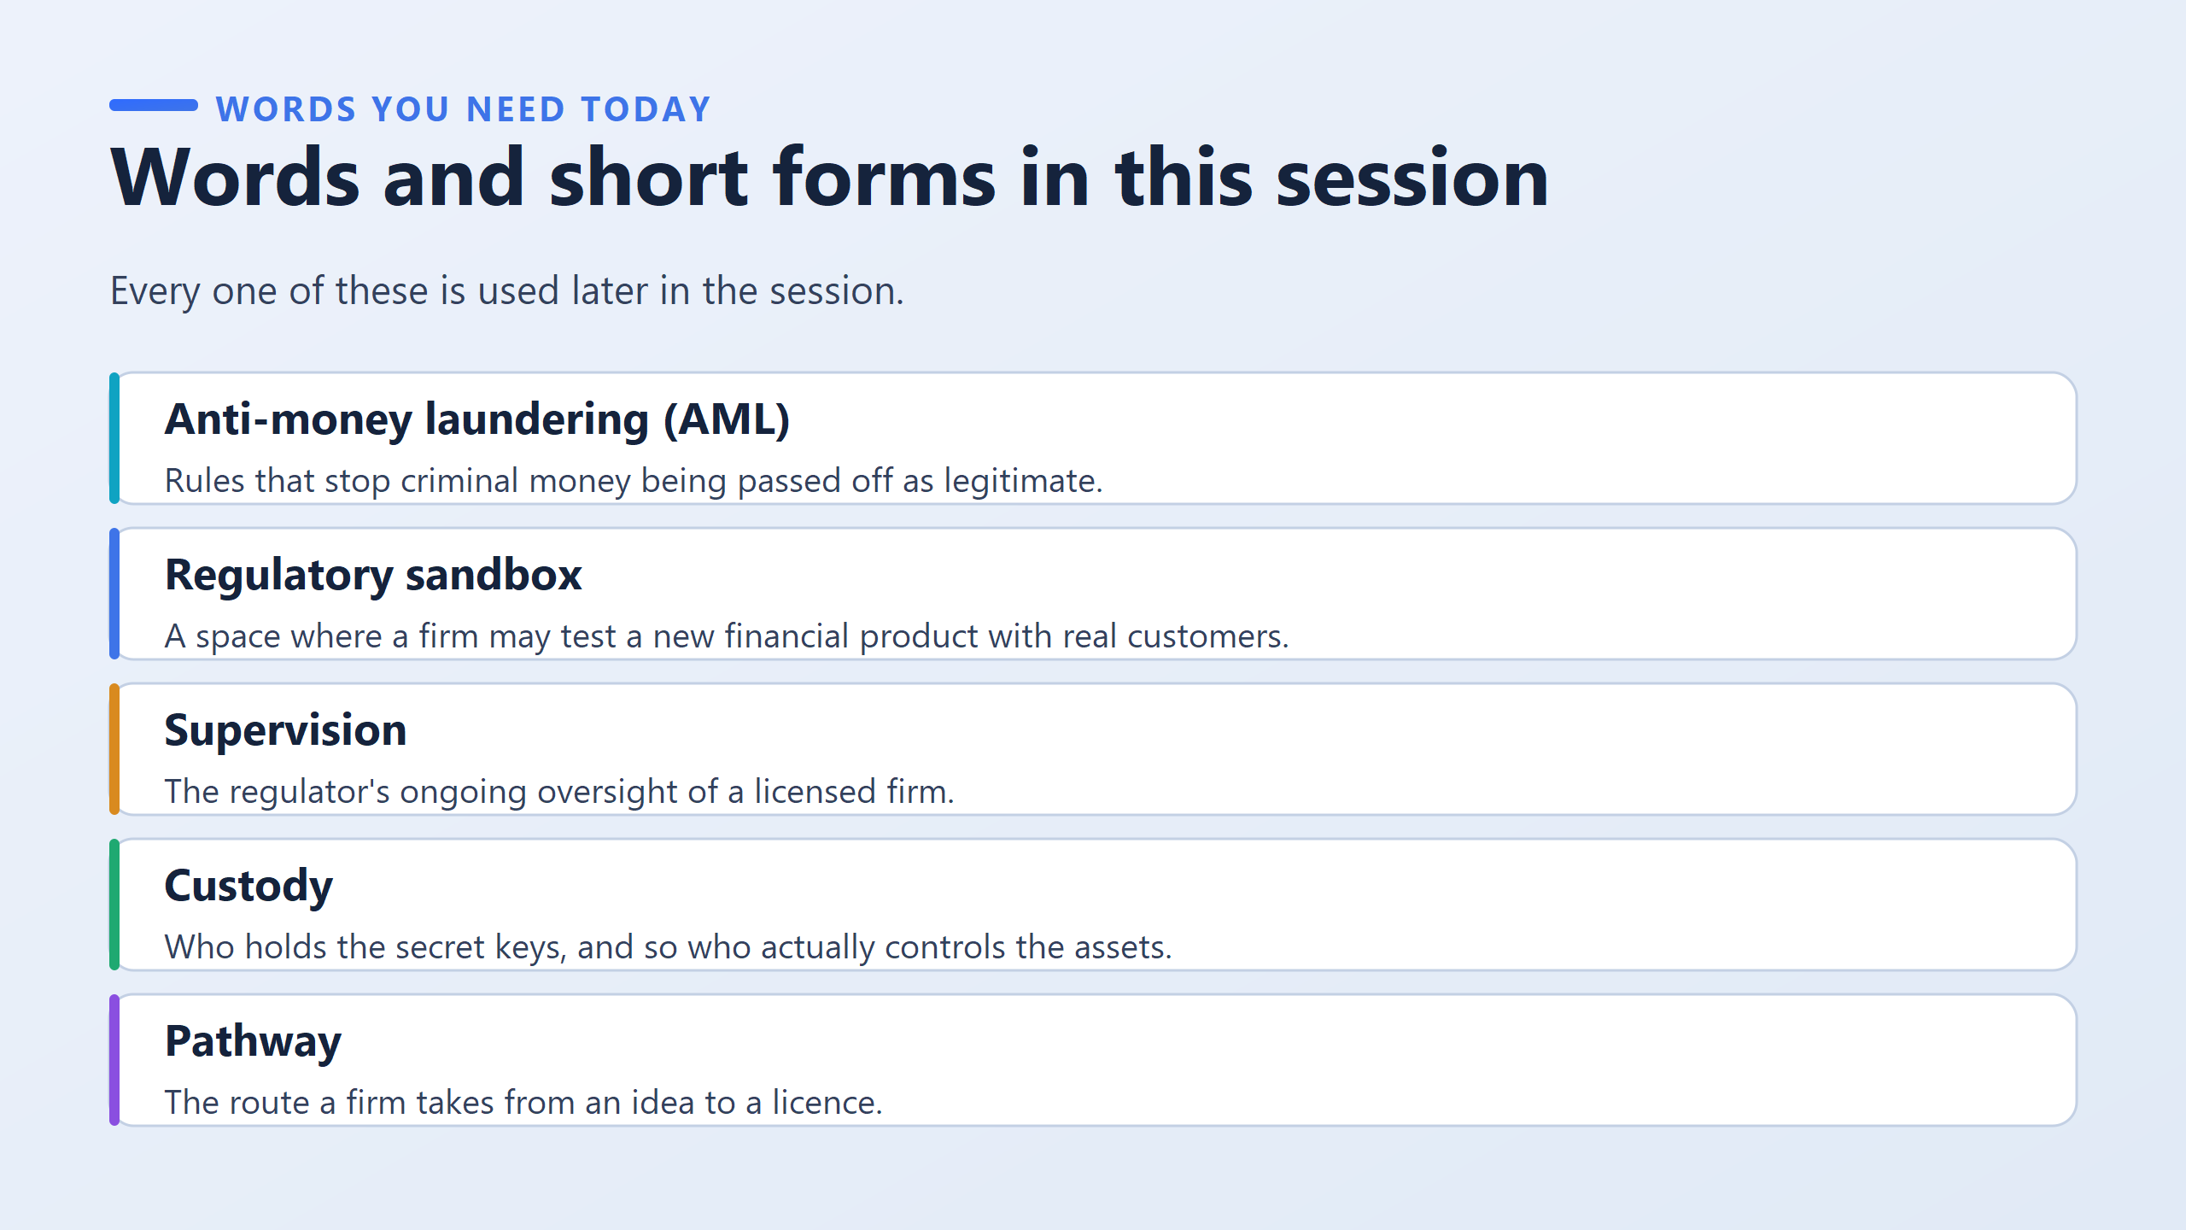
Rules and legal procedures designed to stop criminals from disguising illegal money as legitimate income through financial services.
A regulated, safe environment where startups can test new financial products on real customers with limited risk and under close supervision
The ongoing monitoring and auditing performed by a regulatory authority (such as the CBB) to ensure a licensed firm stays compliant over time.
The step-by-step regulatory route a company must navigate to evolve from a business idea into a fully licensed operating entity

Slide 5
Anti-Money Laundering: These are the mandatory rules and systems
designed to prevent criminals from cleaning dirty money through crypto platforms
2. A Regulatory Sandbox: Think of this as a safe playground provided by the Central Bank. It lets startups test innovative products with real users under direct supervision before getting a full commercial license.
3. Supervision: Getting a license isn’t a one-time check; supervision is the ongoing oversight where regulators continuously inspect a firm's health and operations.
4. Custody: In crypto, “custody” simply answers: Who holds the secret private keys? Whoever holds the keys holds real control over the money.
5. Pathway: This is the exact step-by-step roadmap a startup follows to move from a concept on paper to a fully licensed business.

Slide 6
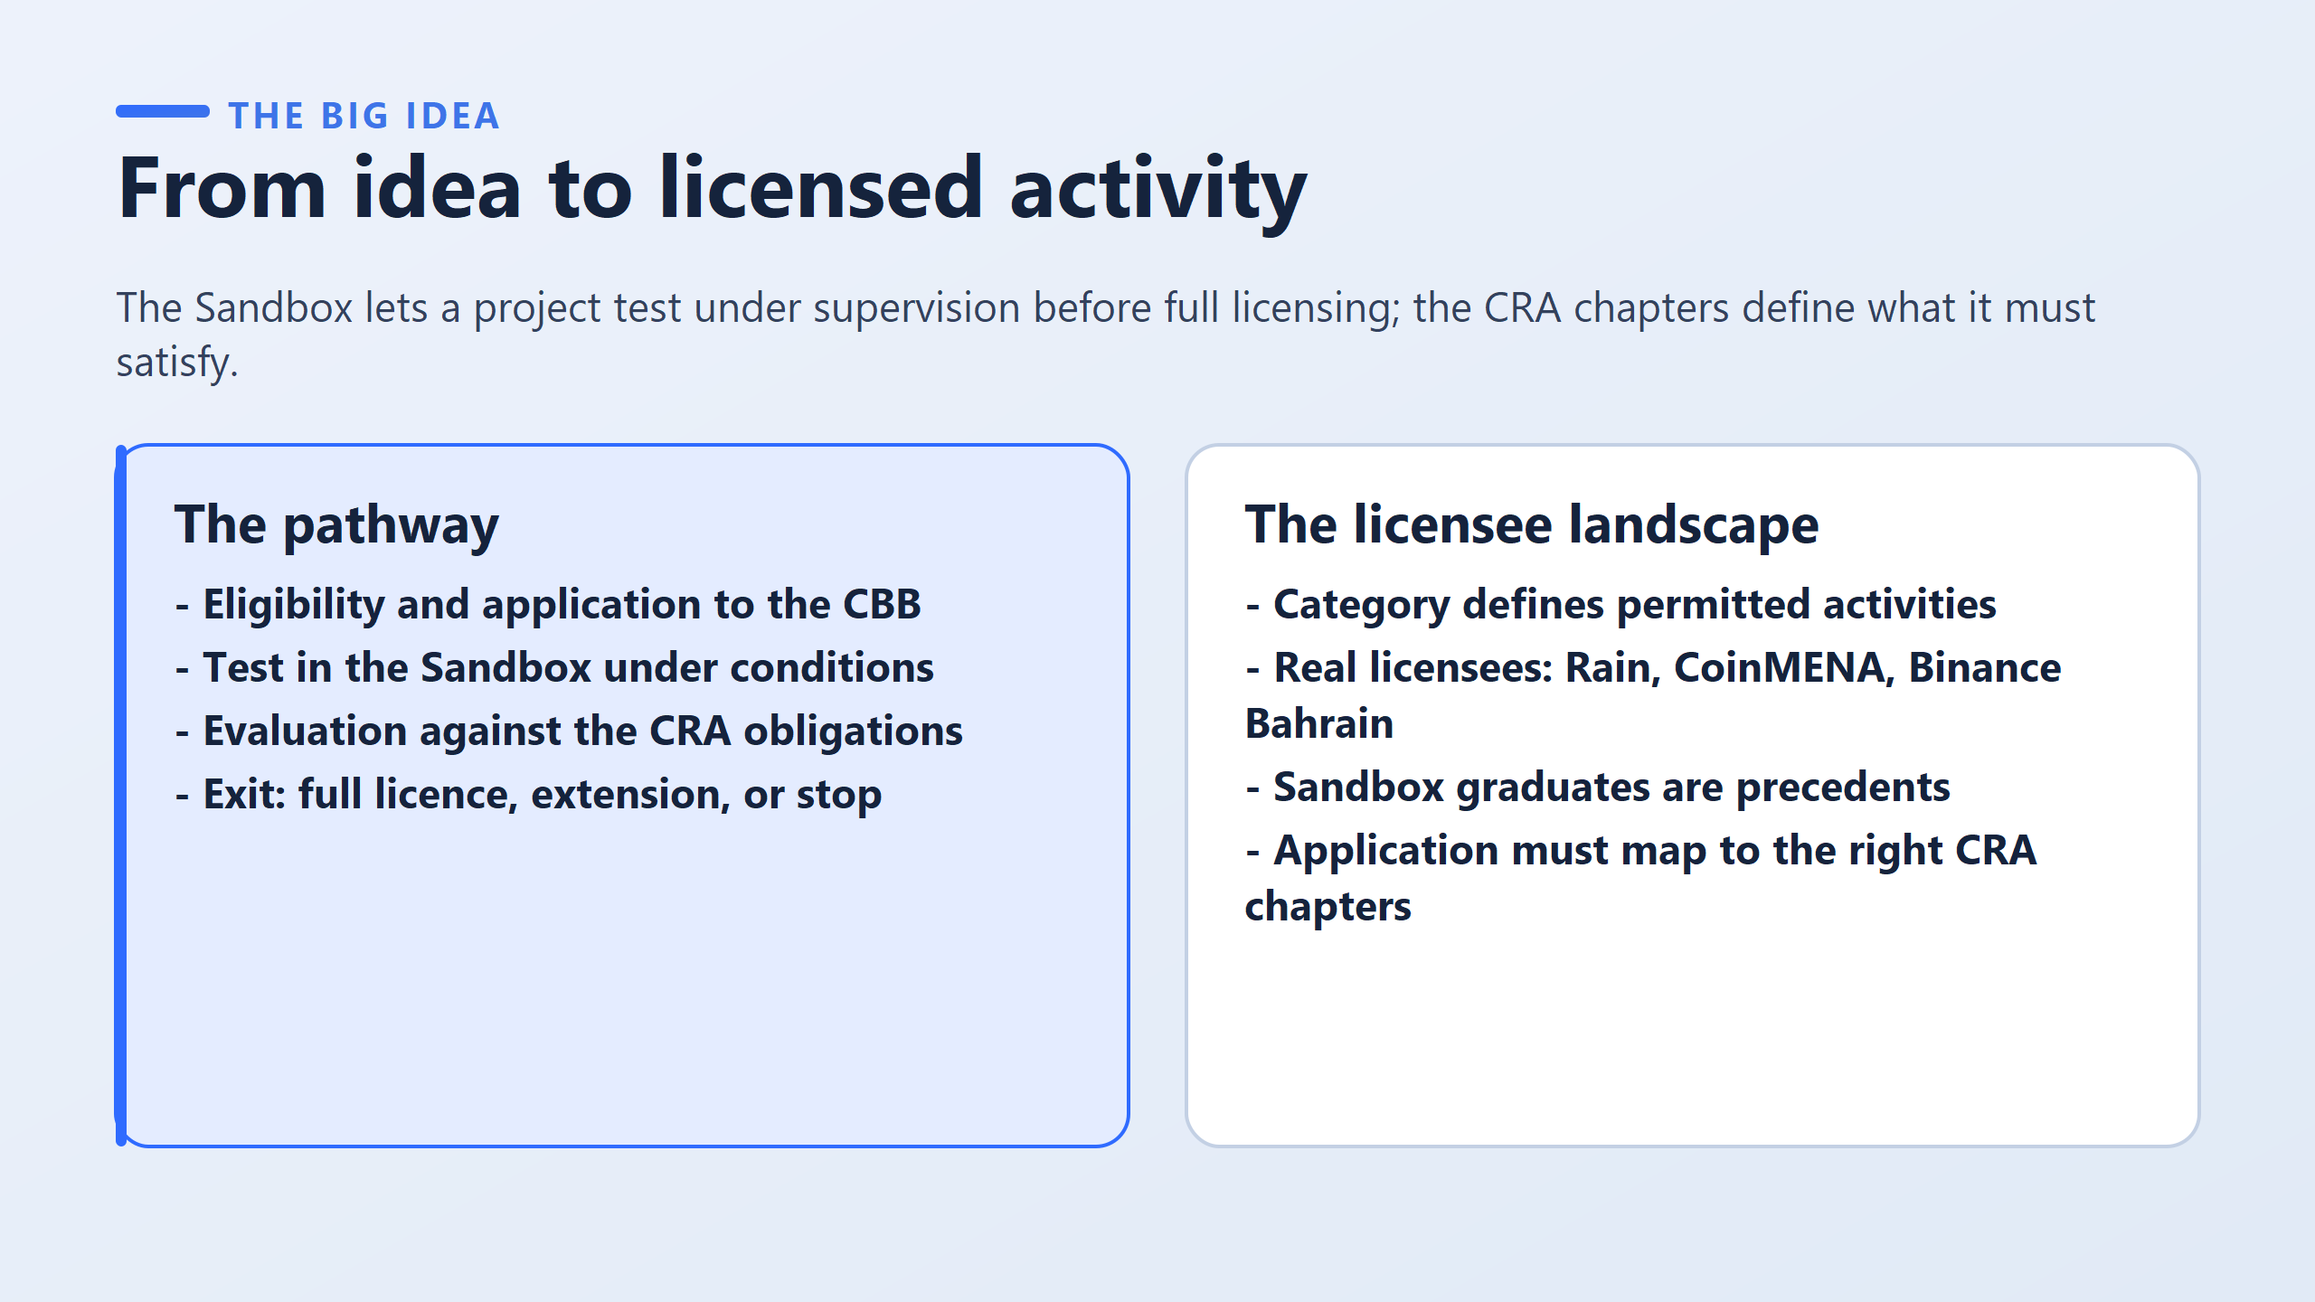
How does a crypto idea actually become a legal business in Bahrain? Imagine you are the Central Bank.
A startup brings you a brand-new crypto platform. You have two bad choices: if you say ‘Yes’ right away, customers might lose money if the tech fails.
If you say 'No', you kill innovation in Bahrain.
What do you do?"
The answer is the Regulatory Sandbox. The sandbox isn’t a fake simulation, a real customers use real money, but the CBB places tight caps on transaction volumes and customer numbers so risks are strictly controlled.
On the left side of the slide, you see the road: you apply, you test under conditions, you get evaluated against CRA rulebook chapters, and finally you exit.
A firm can get a Full License, get an Extension for more testing, or be ordered to Stop. Stopping a risky firm is a success for the regulator because it protects the public! On the right side, we see real examples right here in Bahrain—platforms like Rain, CoinMENA, and Binance Bahrain all successfully navigated regulatory approval to operate legally.

Slide 7
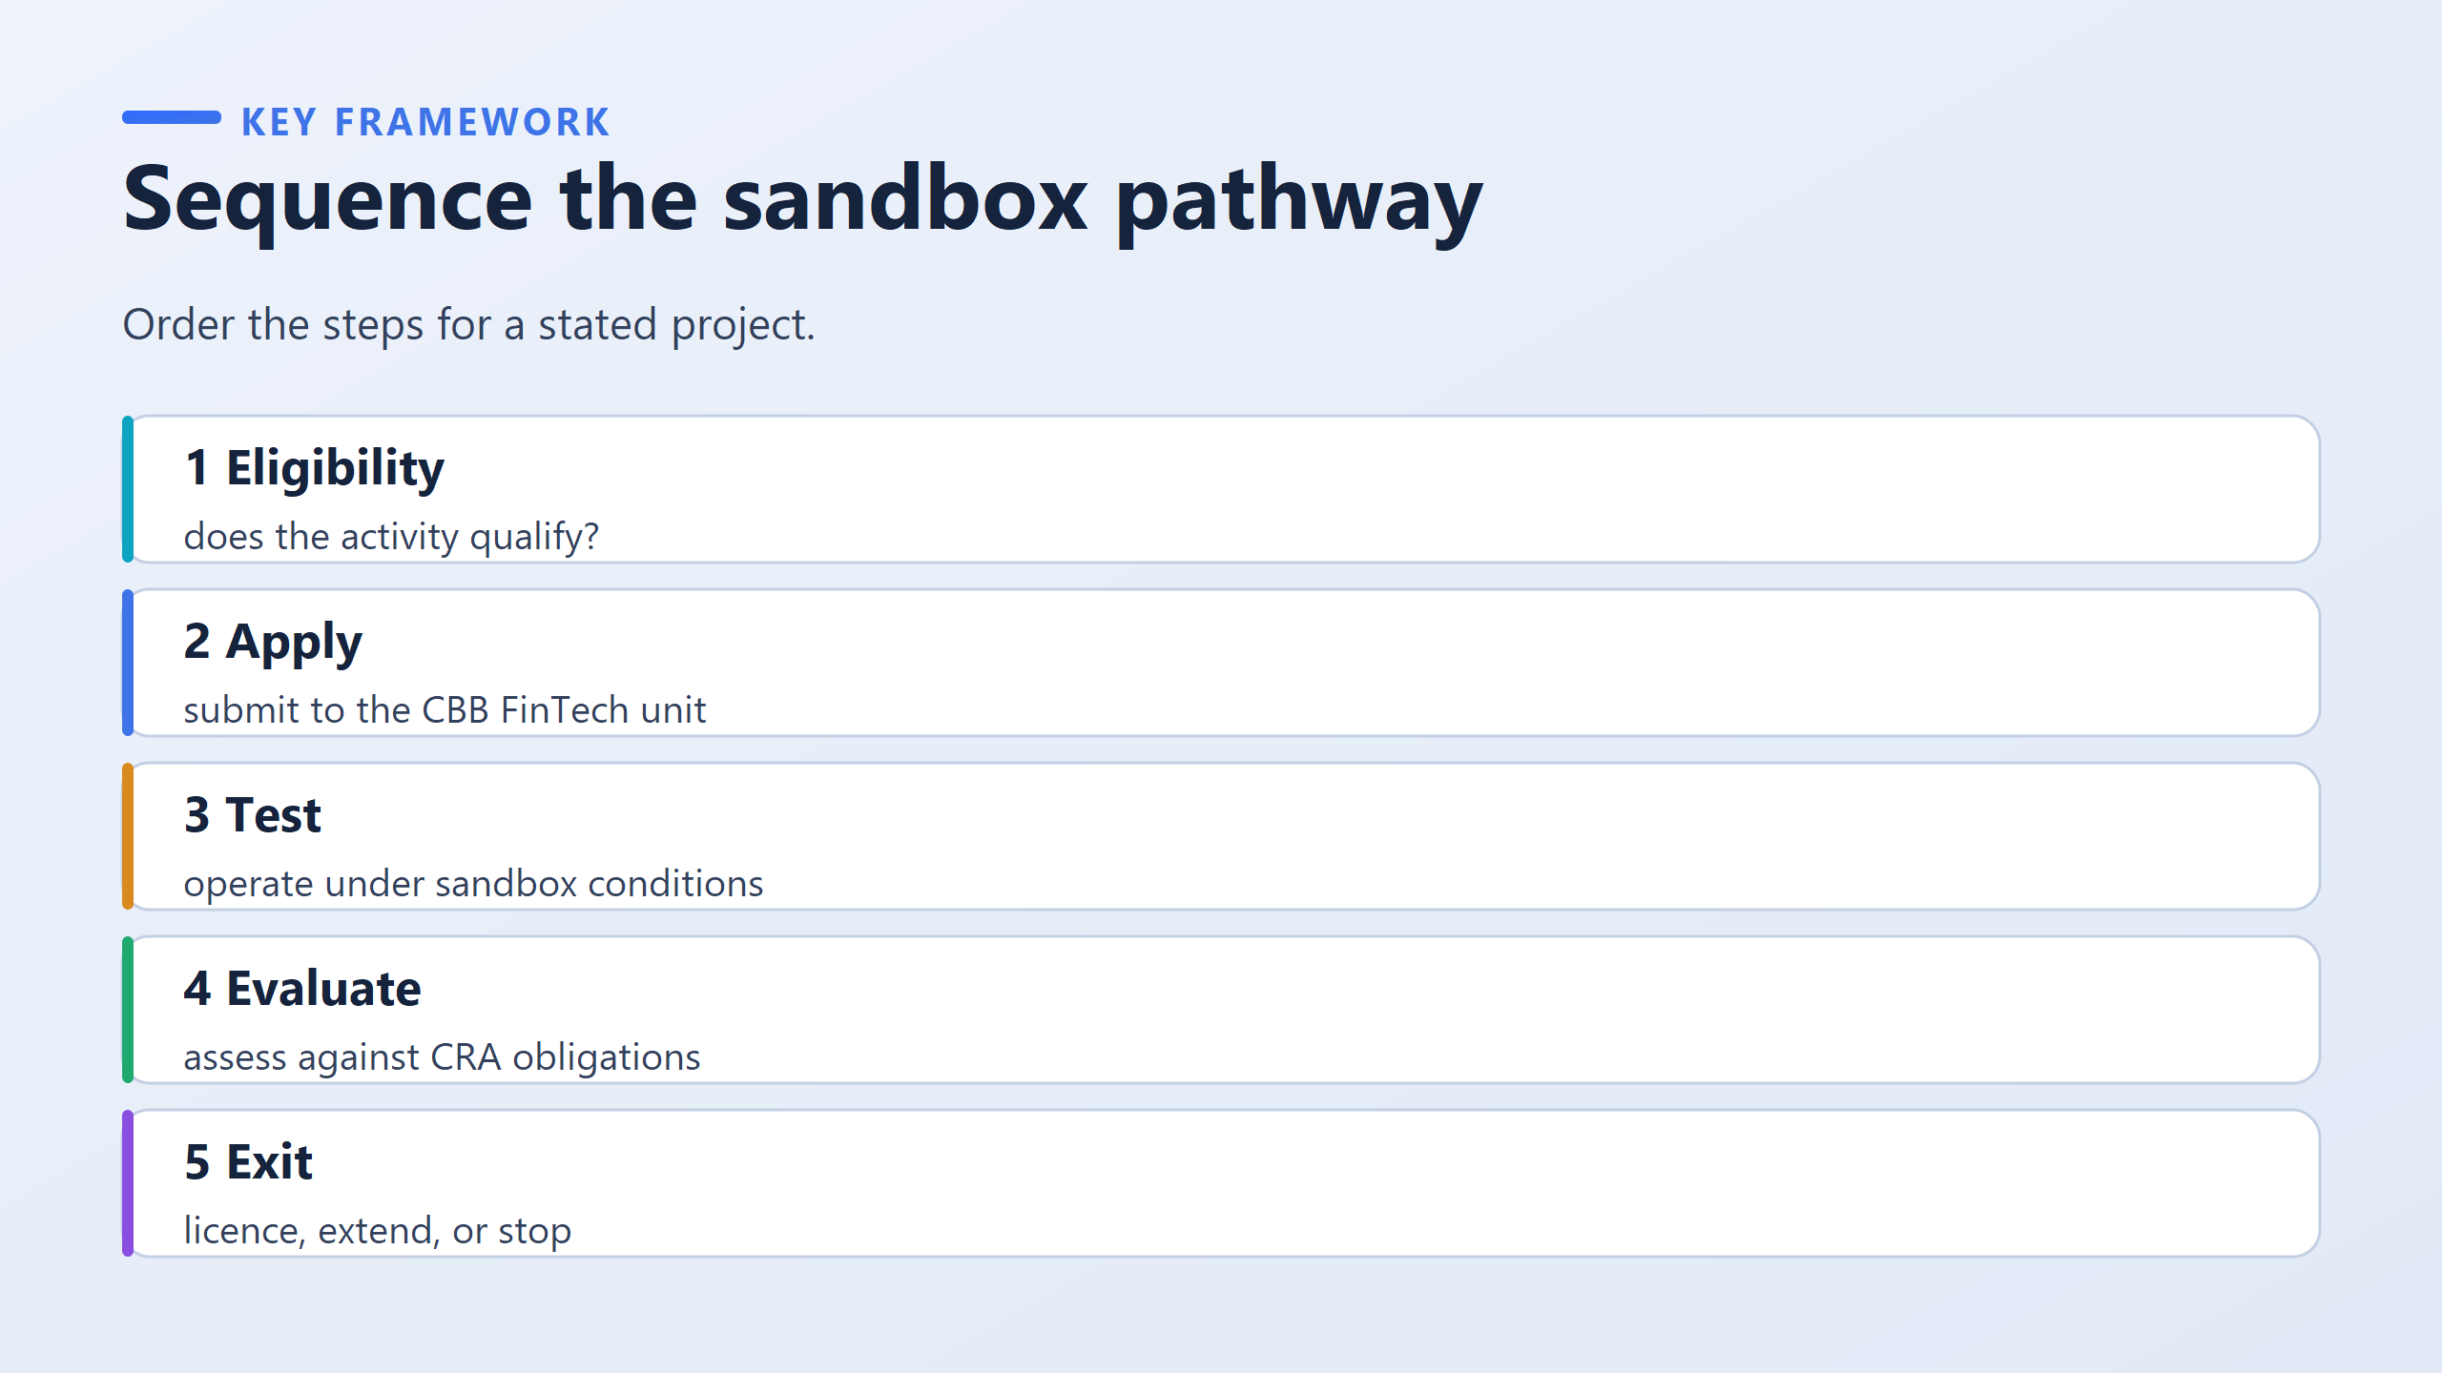
5-stage sequential roadmap that a firm must follow to transition from an idea to a licensed entity in Bahrain
Checks if the business activity actually fits the sandbox scope.
This early gate saves both the CBB and the firm time before writing lengthy applications
Crucial Distinction: An application for a regulator must focus on risk and consumer protection ("What could go wrong?"), whereas an application for an investor focuses on growth and profit ("How big can this get?").
The firm operates under live sandbox conditions with real clients and capped transaction limits, producing real operational evidence rather than theoretical claims
The regulator assesses the live evidence against the CBB Rulebook (Module CRA)
The final outcome: a full commercial license, an extended testing period, or a stop order.

Slide 8
Imagine a team of software developers spent two full years building a high-tech crypto exchange in secret.
They have great code and tested it internally, but zero real customers yet.
Where on this 5-stage roadmap do they start?
They start at Stage 1 (Eligibility), NOT Stage 3! It doesn’t matter how advanced their software is; no regulator has approved their activity yet, so they must start at the very beginning

Slide 9
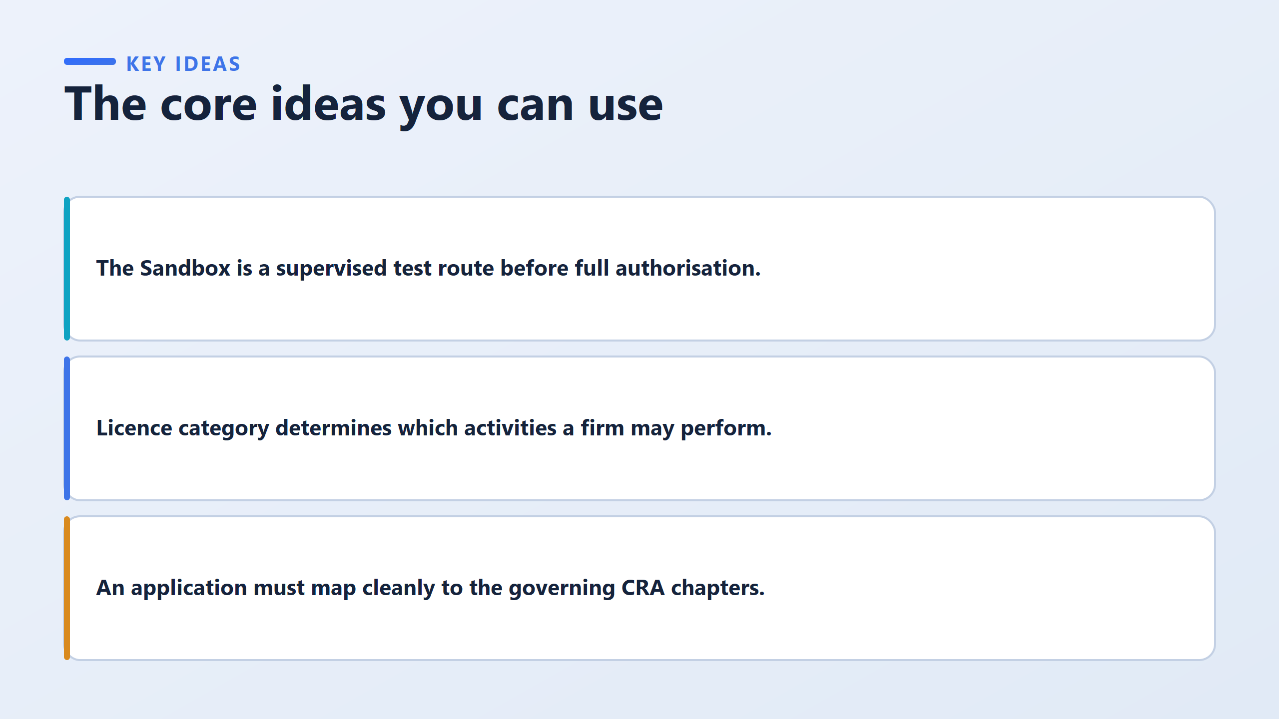
The Sandbox is a test route for evidence.
Regulators don't grant full authorisation based on a pretty pitch deck.
They want to watch you handle real customers and real money under supervised conditions so you can prove your systems work.
Licenses are given for specific permitted activities, not general corporate status
In Bahrain’s CBB rulebook, licenses are tiered into Categories 1 through 4 depending on what you do
For example, giving investment advice carries much lower risk than holding private keys for customer custody, so the regulatory proof required is very different
Applications must map cleanly to CRA chapters.
You cannot just write a general business proposal
You must explicitly show the regulator how each obligation in the rulebook is met

Slide 10
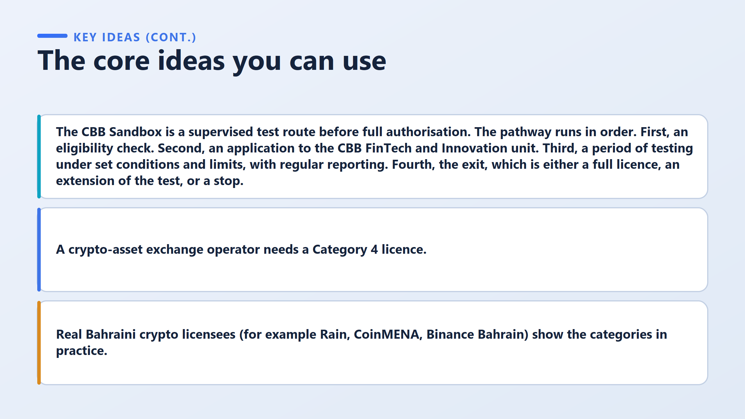

Crypto-asset license category Minimum capital
Category 1 BHD 25,000
Category 2 BHD 100,000
Category 3 BHD 200,000
Category 4 BHD 300,000
A firm operating a crypto-asset exchange must hold a Category 4 License
Category 4 is the highest tier of crypto license in Bahrain (requiring BHD 300,000 in capital)
look at real platforms operating right here in Bahrain, such as Rain, CoinMENA, and Binance Bahrain.
Don’t fall into the trap of thinking a big international brand can skip local rules—even global giants must obtain CBB permission for their specific local activities.

Slide 11
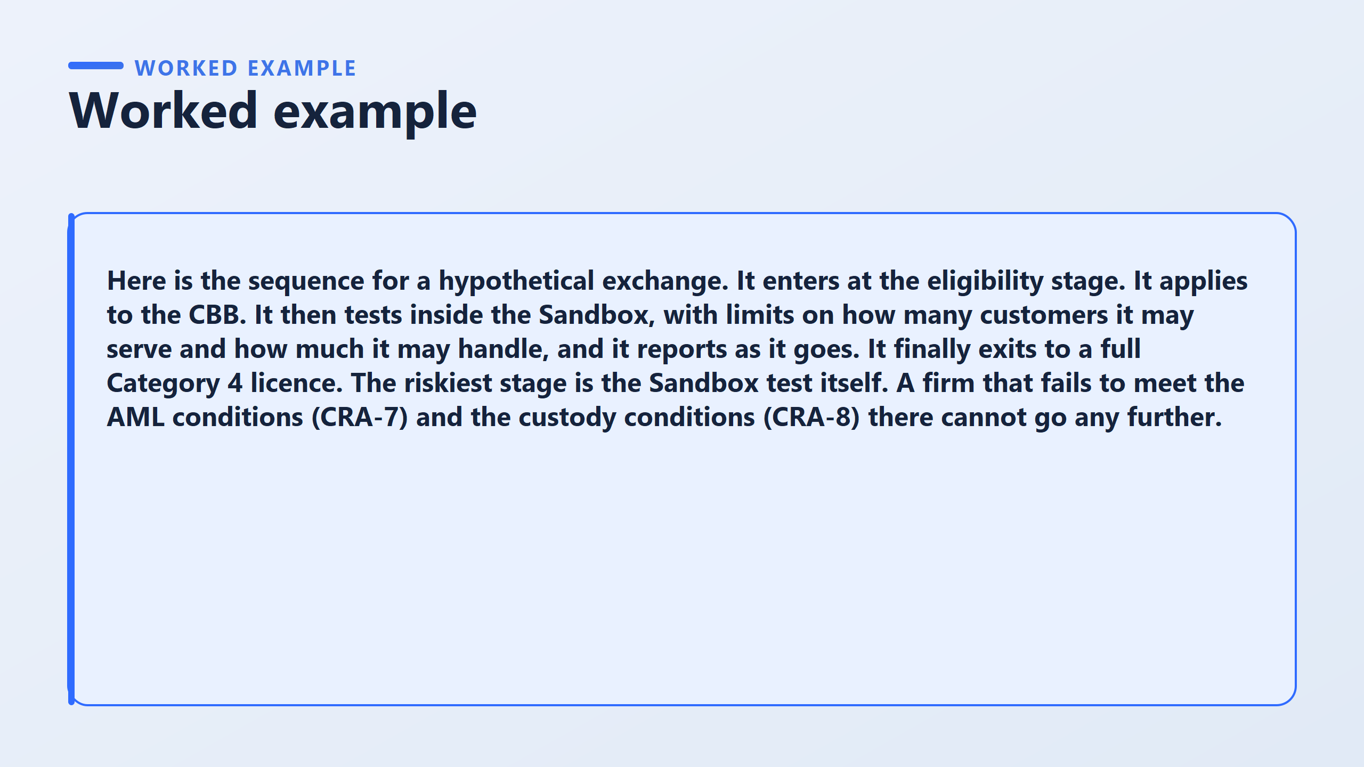

Slide 12
Let’s look at a concrete worked example of a new crypto exchange going through the pathway.
When analyzing a project, a complete answer must address three key elements:
  Where does it enter? It enters at Stage 1 (Eligibility) because no regulator has approved its activity yet.
  What happens along the way? It applies to the CBB (Stage 2), enters Sandbox Testing under transaction caps (Stage 3), and exits into a Category 4 License (Stage 4)—because operating an exchange requires Category 4.
  Which stage is most likely to stop it? This is where the marks are! The biggest risk isn't getting rejected on day one at the application stage.
The riskiest stage is the Sandbox Test itself.
  Why? Because writing a policy on paper takes an afternoon, but running Anti-Money Laundering (AML under CRA-7) identity checks on every single live user without fail, and securing client private keys under Custody rules (CRA-8) 24 hours a day for months is extremely difficult.
If a startup fails these ongoing operational checks, they cannot go any further.

Slide 13
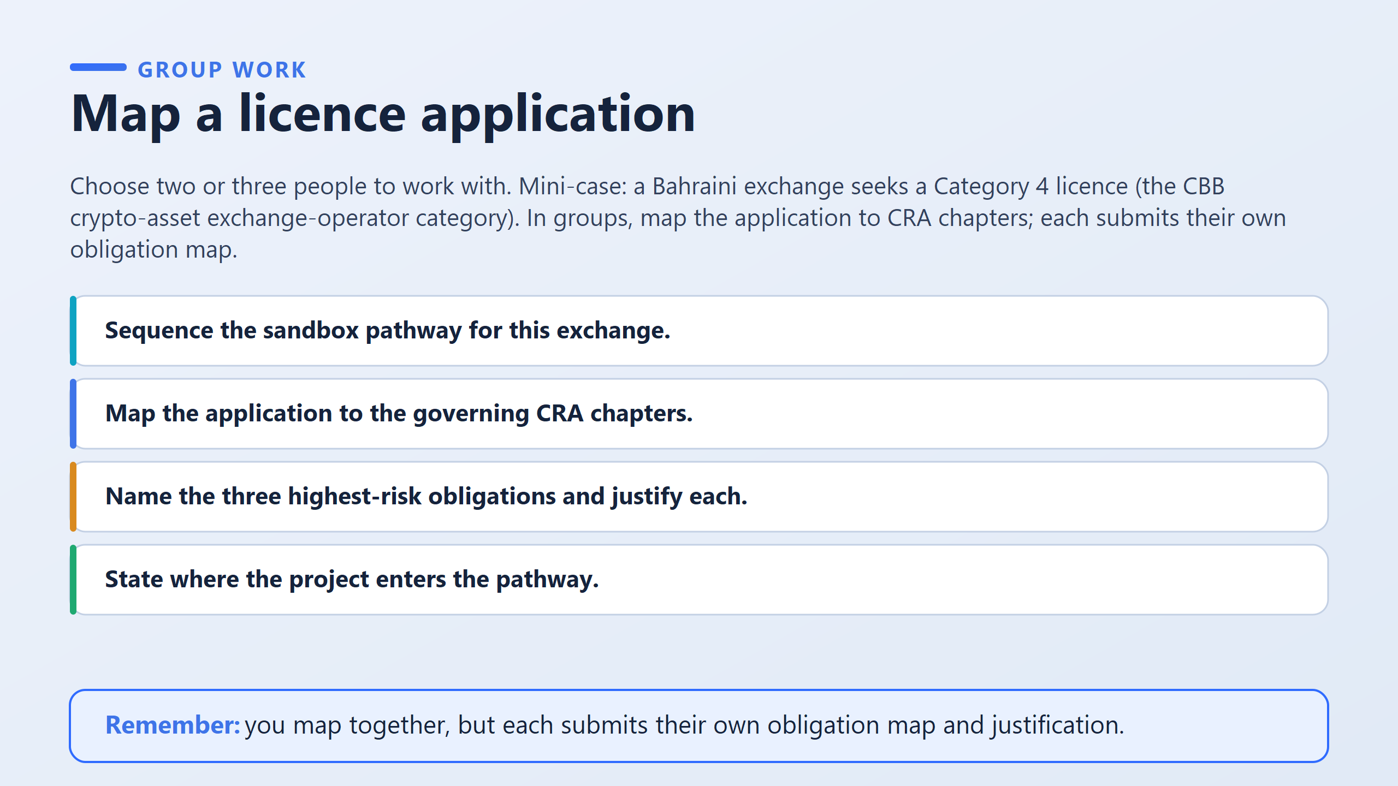

Slide 14
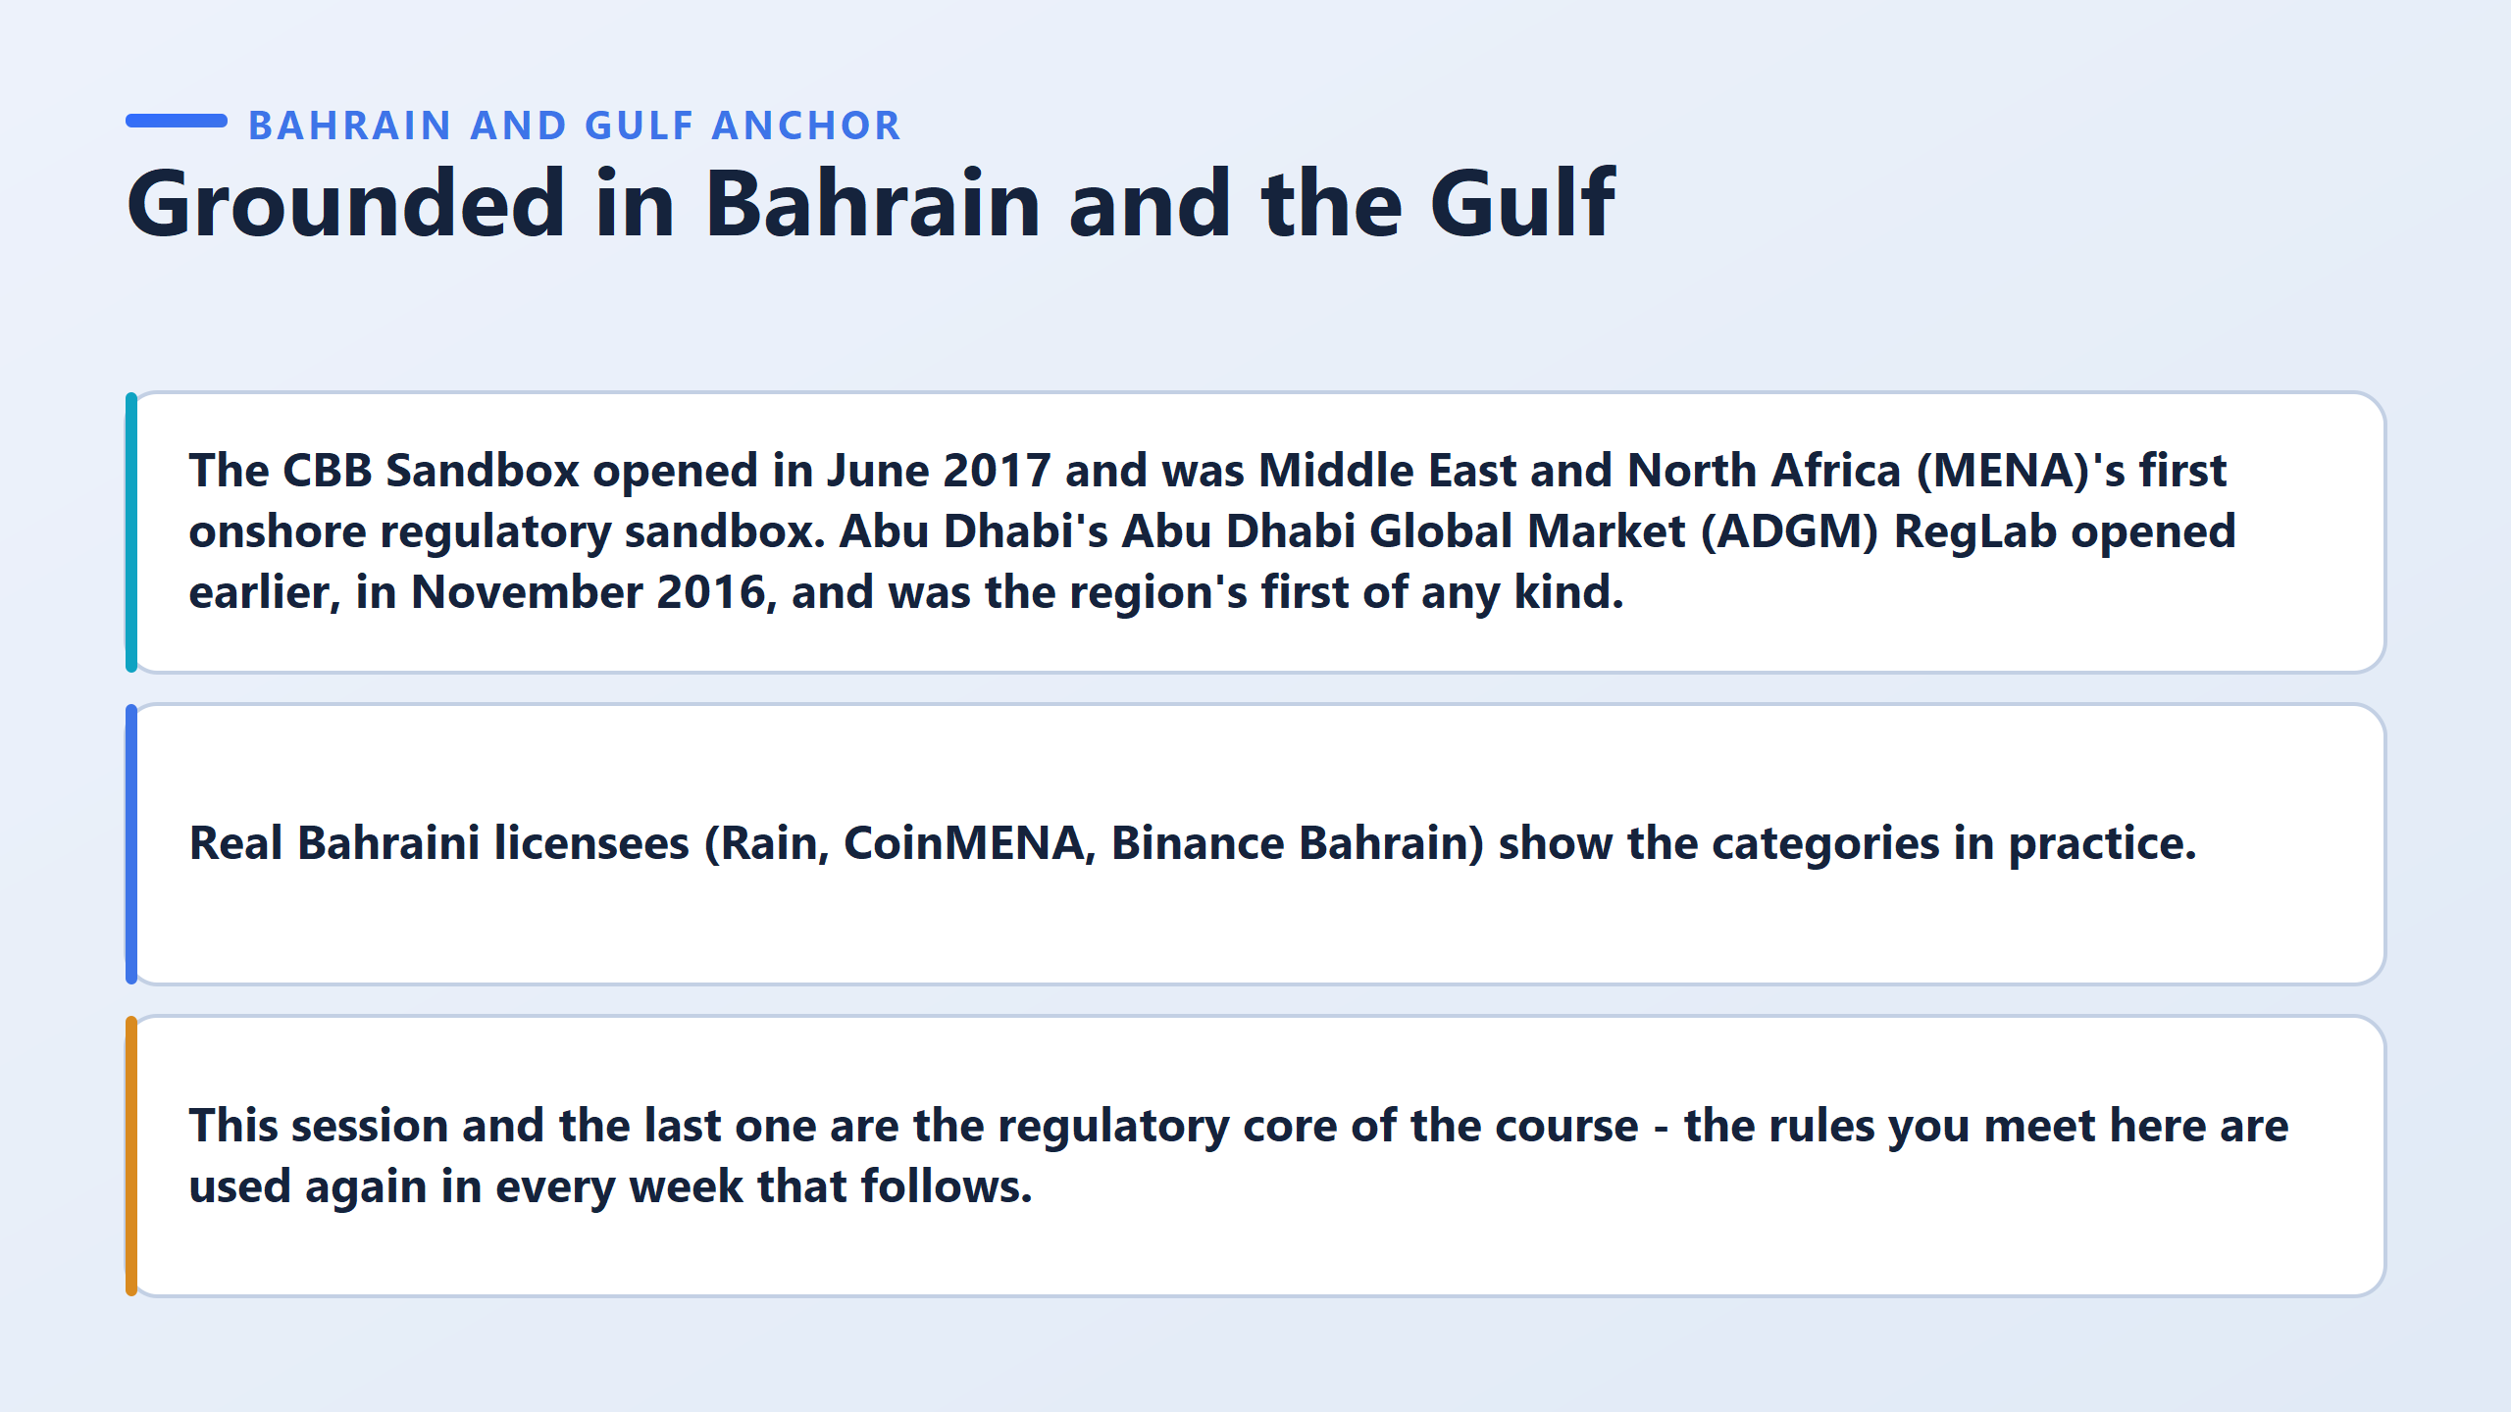

Slide 15
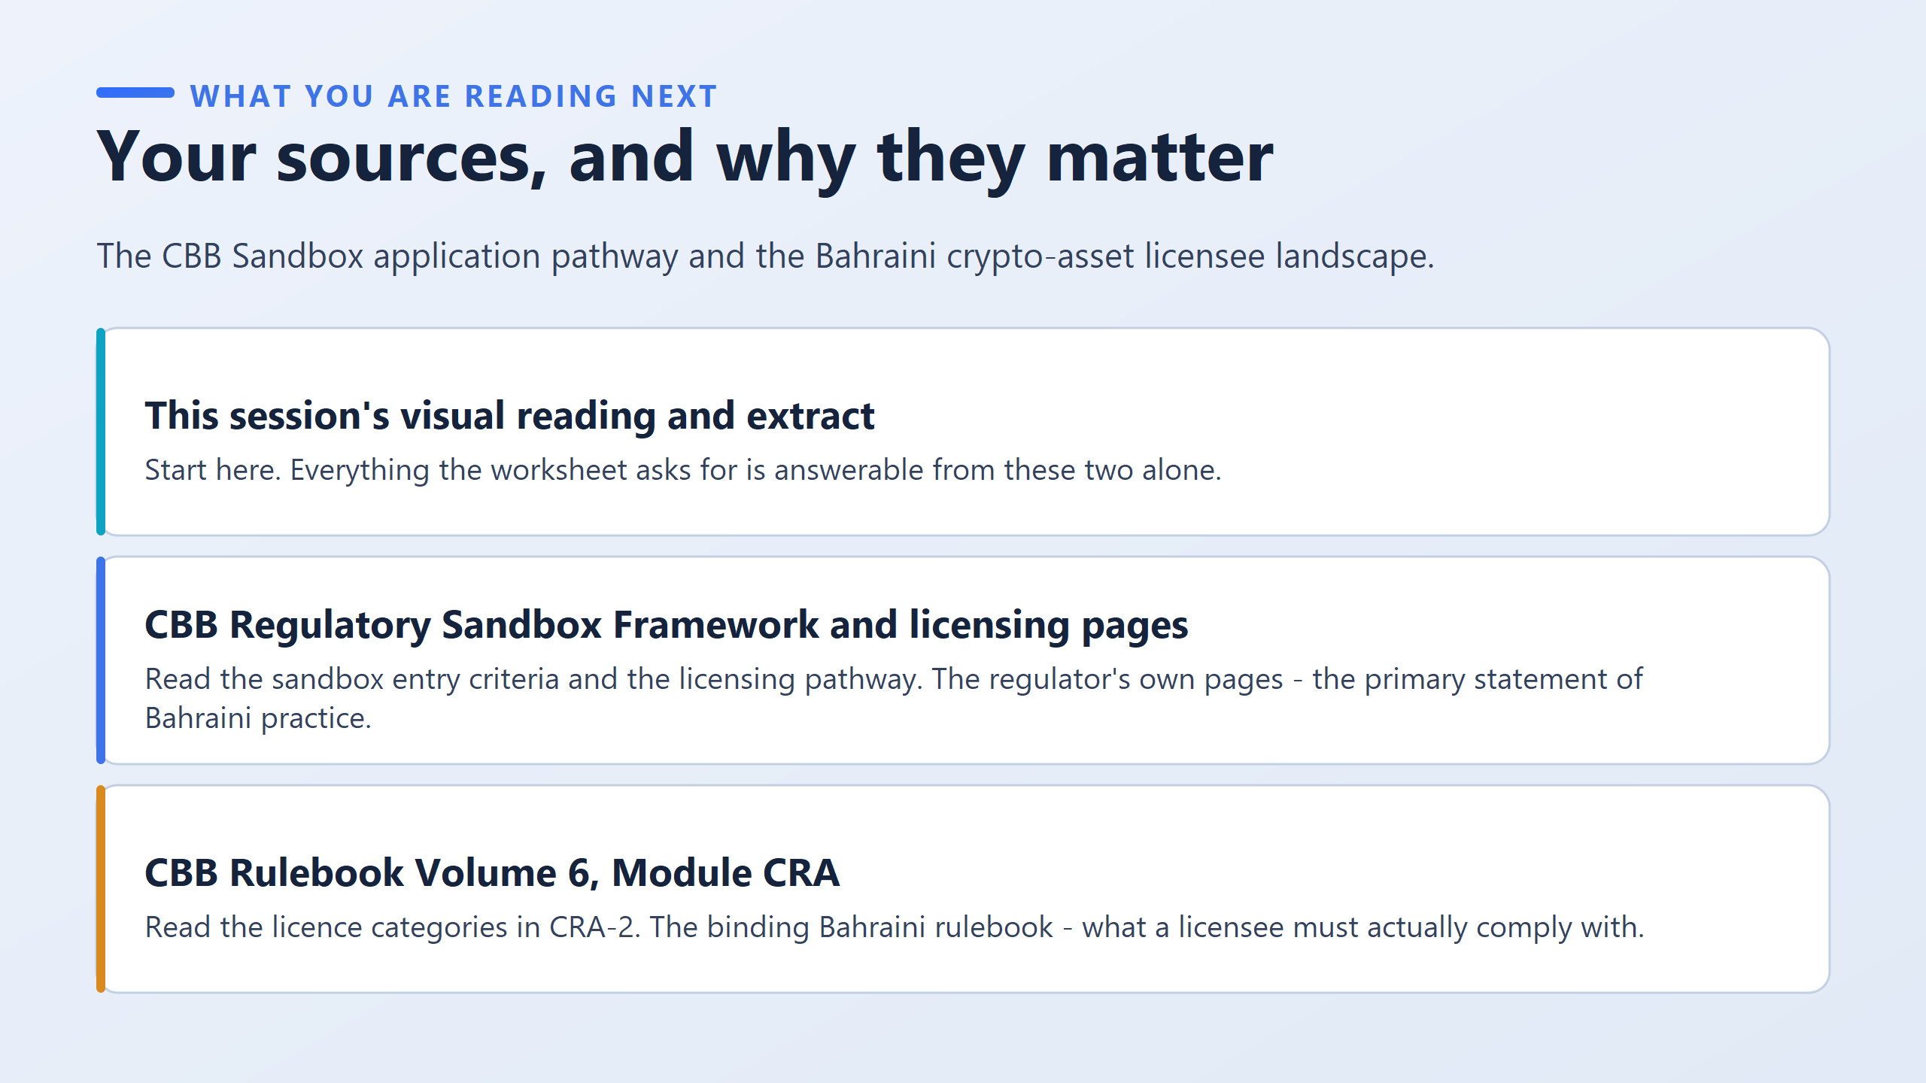

Slide 16
